Slide 1
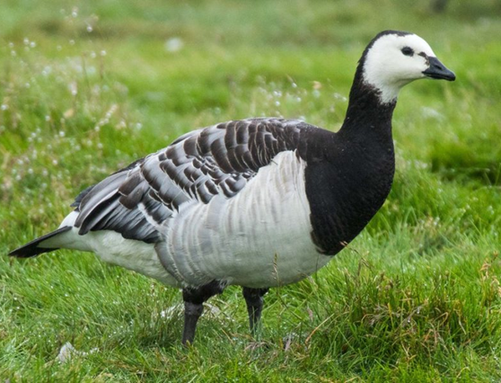
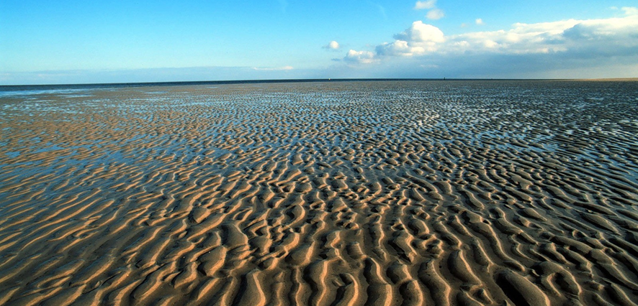
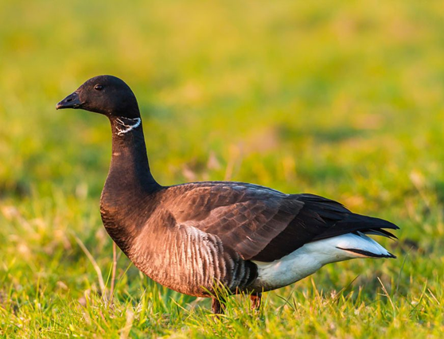
Vigilance behaviour in geese at the Wadden Sea
Research project by Johanna Baumgart, Pranjel and Franziska Rimatzki

Slide 2
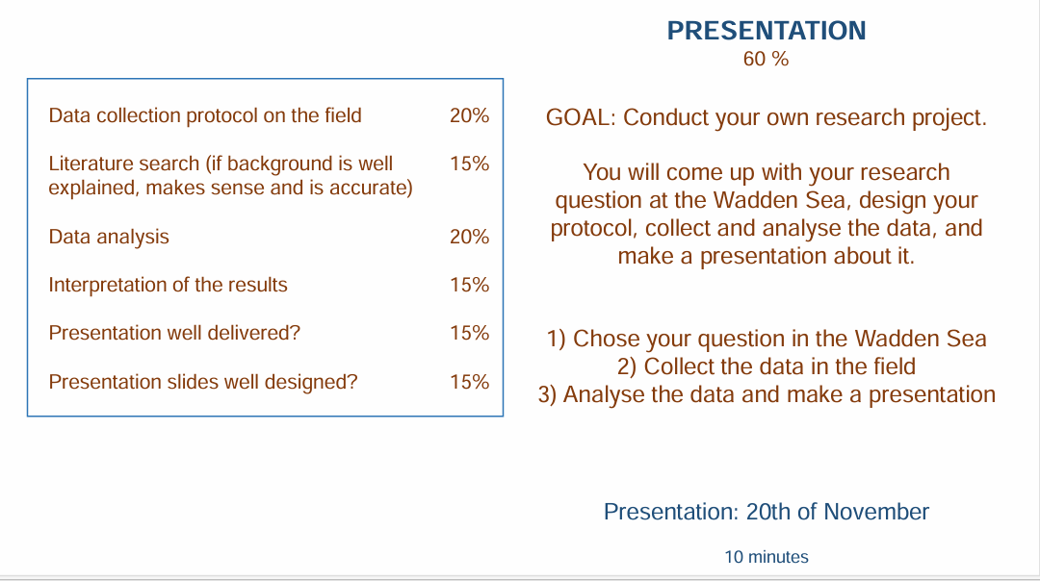
stuff to keep in mind for the presentation:

Slide 3
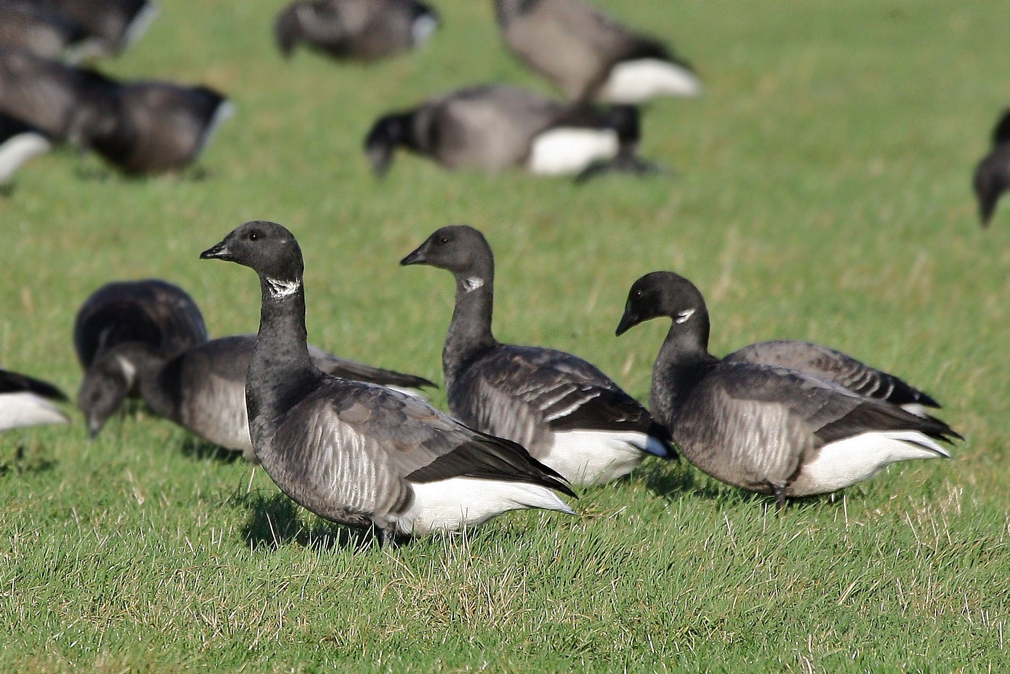
From Feeding to Looking Up
Geese switch between head-down feeding and head-up scanning
We focused on these head-up moments
They reveal how geese react to their surroundings

Slide 4
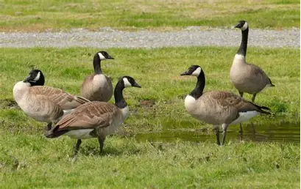
Head-Up = Vigilance
Head-up scanning detects danger or disturbance (Lazarus, 1978)
Short pauses give important information (Black et al., 1992)
Each glance reduces feeding time

Slide 5
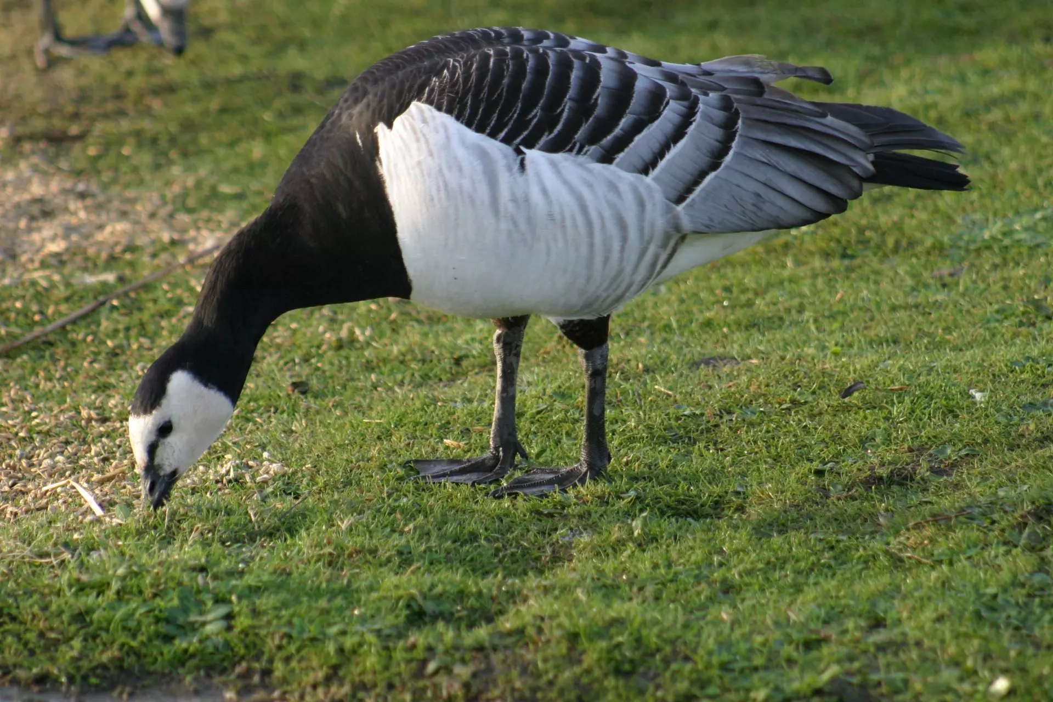
Balancing Food and Safety
Feeding gives energy
Vigilance gives safety
Geese must balance these two needs (Dingemanse & Wolf, 2013)

Slide 6
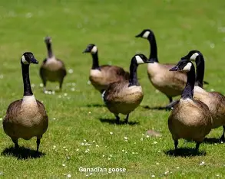
Groups Help Share the Work
Many individuals = many eyes (Beauchamp, 2008)
Less scanning needed per individual (Black et al., 1992)
Group living reduces risk

Slide 7
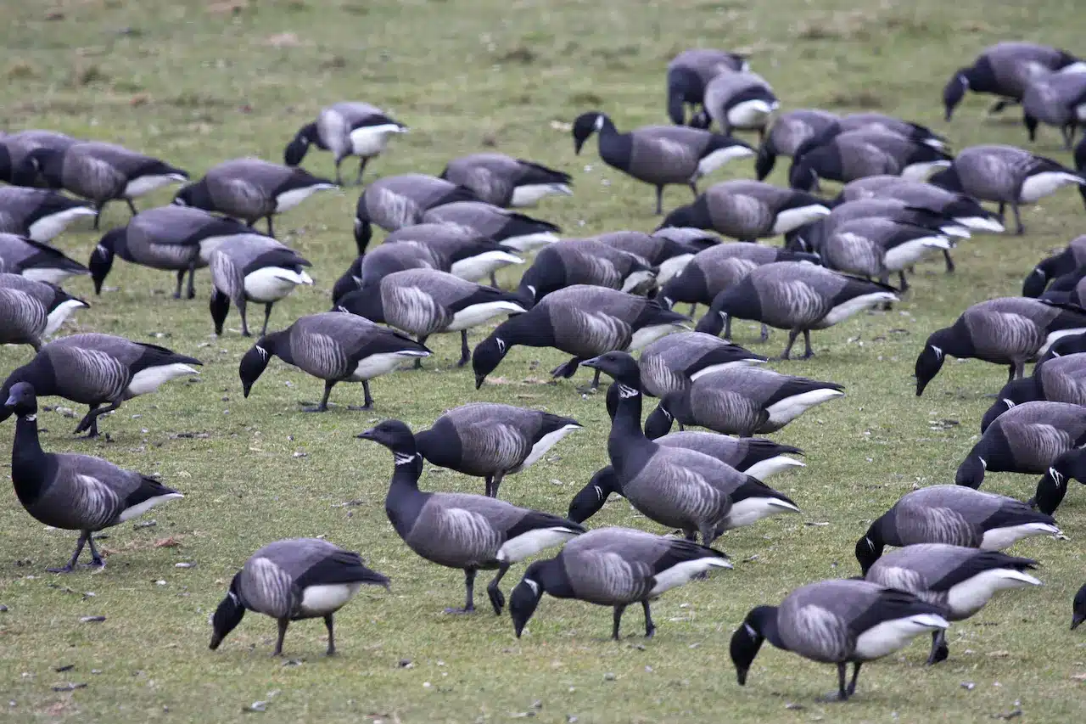
Where You Stand Matters (Edge Effect)
Edge birds face more danger (Inglis & Lazarus, 1981)
Center birds are more protected
Edge birds show higher vigilance
Larger flocks = fewer edge birds

Slide 8
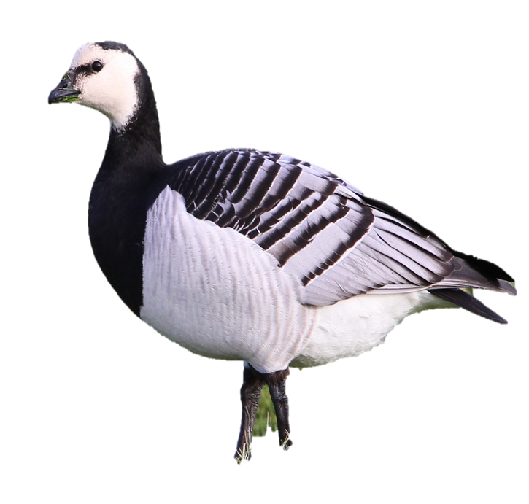
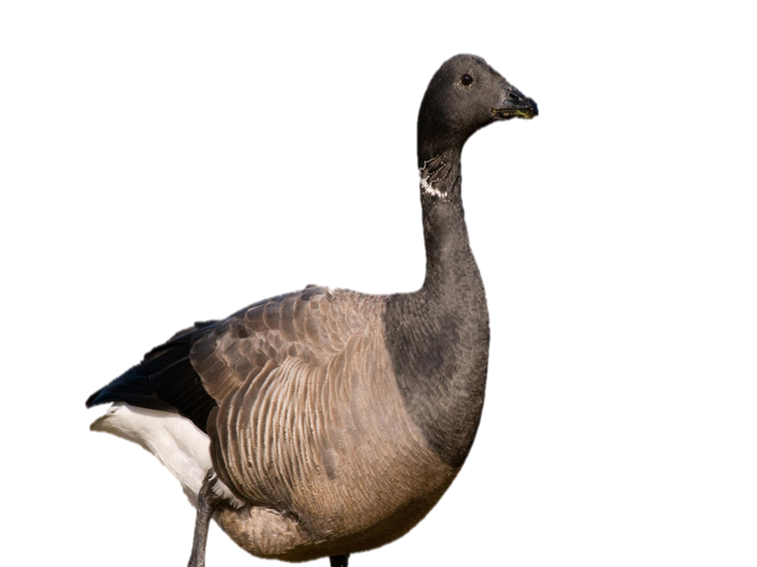
Species We Studied
Brant Geese (Branta bernicla)
Darker head and neck, small white
necklace
Often feeds in coastal/tidal areas (Clausen
et al., 2012)
Barnacle Geese (Branta leucopsis)
White face, black neck
Grazes mainly on grasslands (Black &
Owen, 1989)

Slide 9
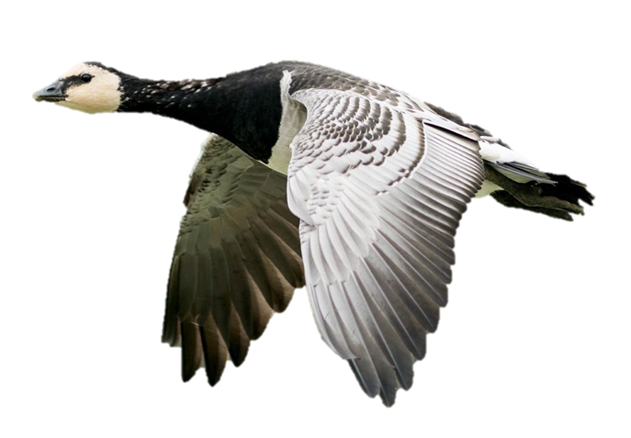
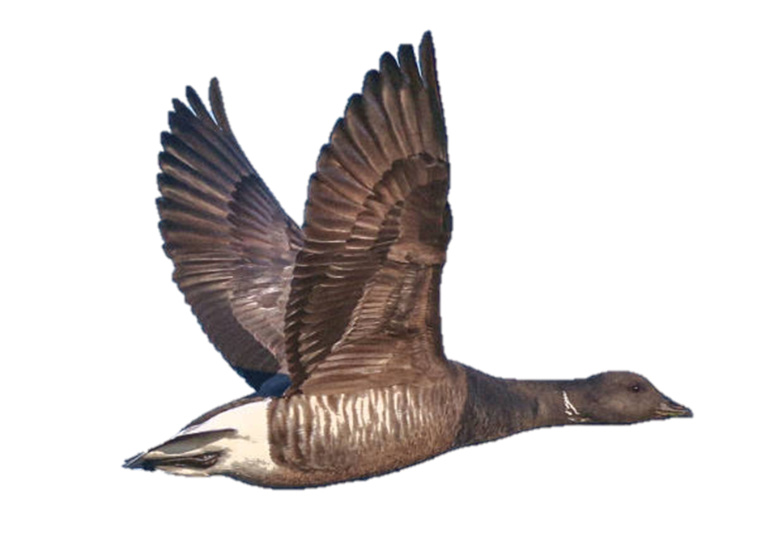
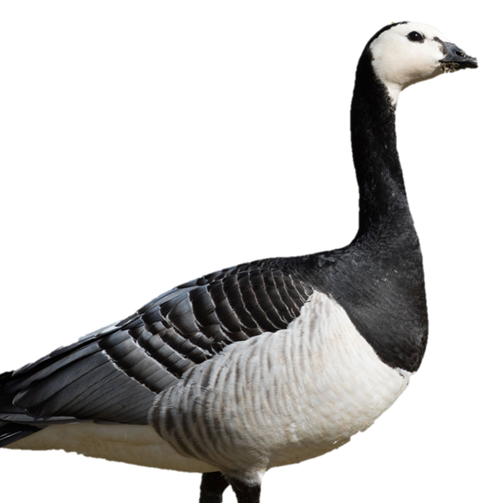
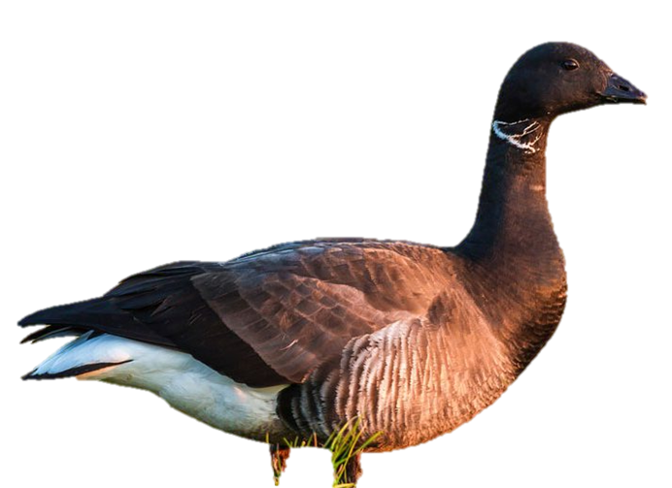
Research Questions
&
Hypotheses

Slide 10
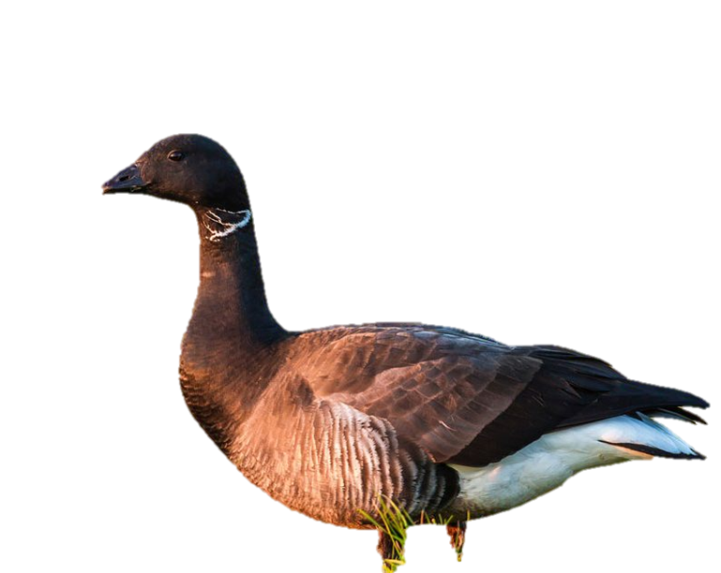
1. Does vigilance change with distance to the observer? (Frid & Dill, 2002)
H1: Vigilance will be higher at closer distances because geese may see humans as a risk (Frid & Dill, 2002)

Slide 11
2. Do center birds show different vigilance than edge birds? (Inglis & Lazarus, 1981)
H2: Edge birds will show higher vigilance than center birds (Inglis & Lazarus, 1981)

Slide 12
3. Do Barnacle and Brant geese differ in vigilance behaviour? (Black & Owen, 1989)
H3: Barnacle and Brent geese will show different vigilance patterns (Black & Owen, 1989; Clausen et al., 2012)

Slide 13
4. Does flock size influence vigilance (Many eyes vs. Edge Effect)? (Black et al., 1992)
H4: Vigilance will decrease with flock size due to the Many-Eyes effect (Beauchamp, 2008)

Slide 14
Material
&
Methods

Slide 15
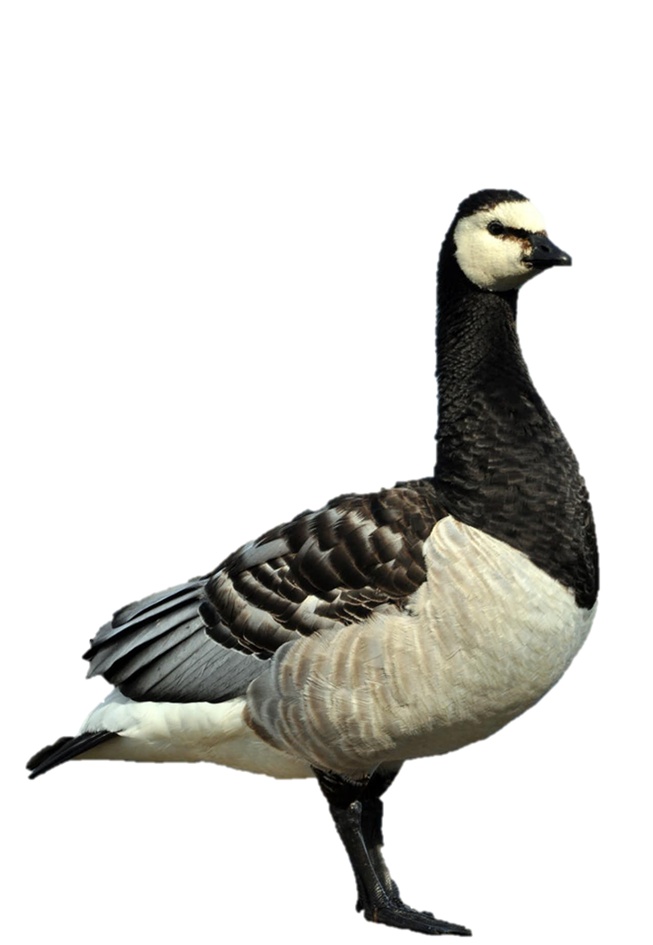
Materials Used
Smartphone for 1-minute video recordings
Binoculars for spotting, flocksize and species ID
Field notebook / phone for metadata
Three observers wearing neutral jackets to avoid disturbance
Only one person reaches out to the geese (always the same)

Slide 16
Methods
Recorded flocks at 20 m, 40 m, 60 m
1-minute video per distance for each flock
Same individuals followed when possible

Slide 17
Measured
Head-up frequency
Head-up duration
Flock position (center vs edge)
Flock size
Species
Used focal animal sampling from videos
Non-intrusive approach to avoid affecting behaviour

Slide 18
Analysis
all flocks with n < 12 got excluded to avoid pseudo replication
analysis in R
linear model for all variables
t-test for differences in species
t-test for differences in positions

Slide 19
Results

Slide 20
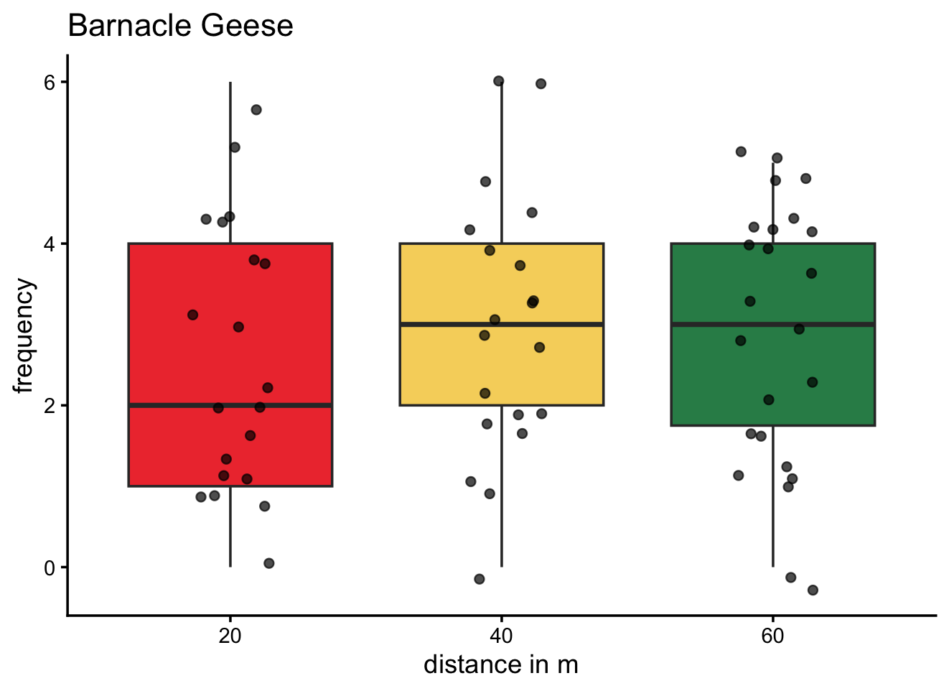
H1: Differences in frequency due to differences in distance

Slide 21
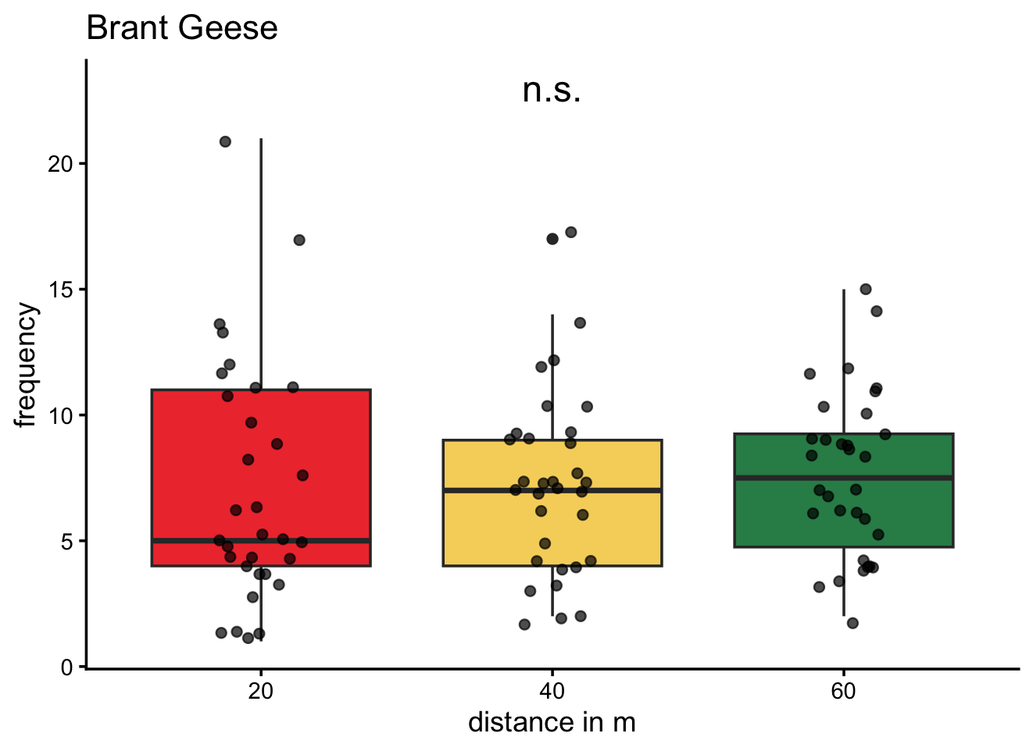
H1: Differences in frequency due to differences in distance

Slide 22
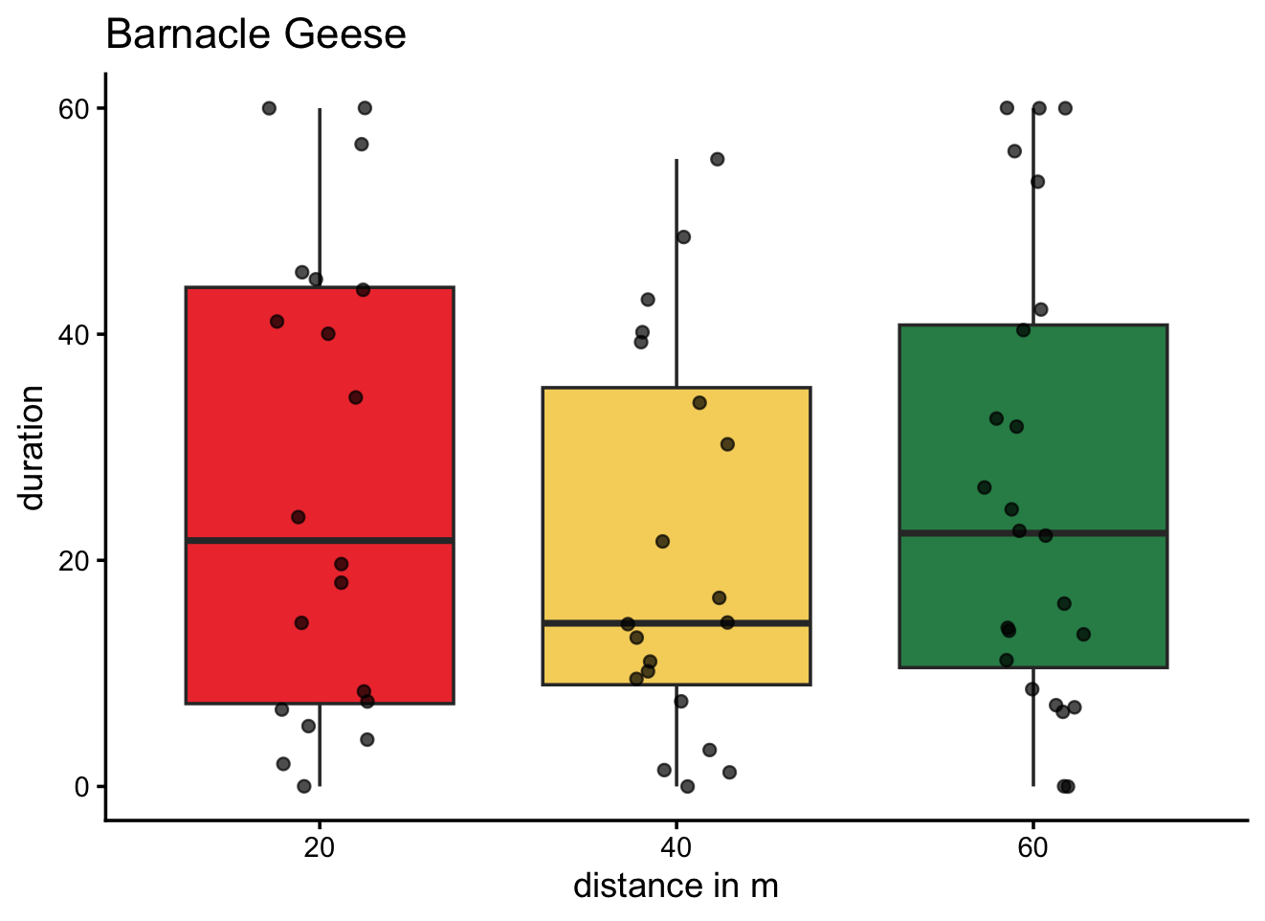
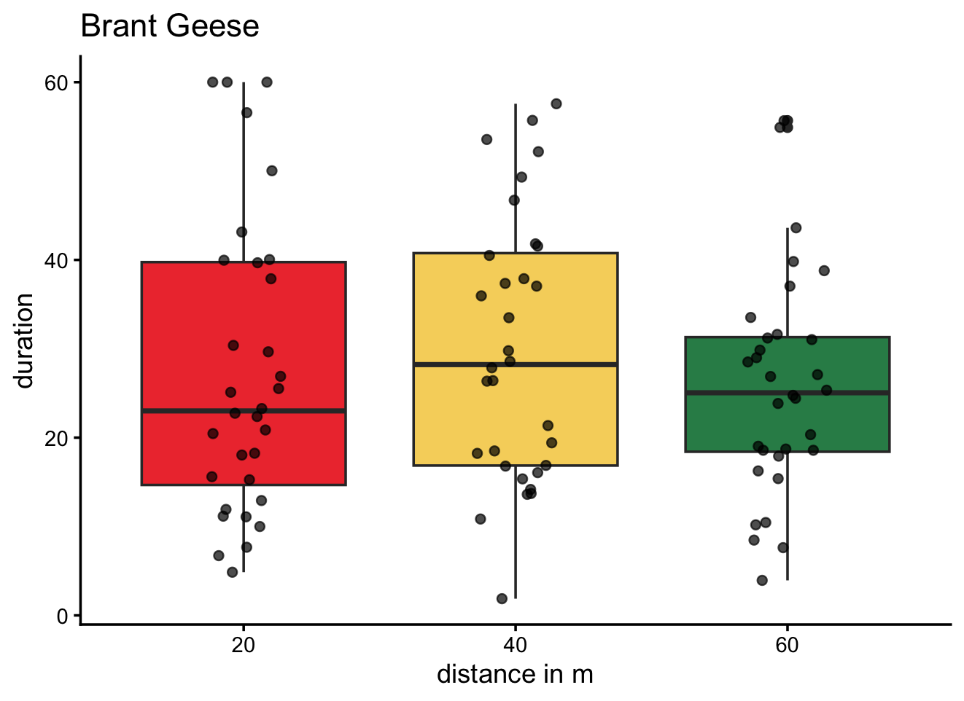
H1: Differences in duration due to differences in distance

Slide 23
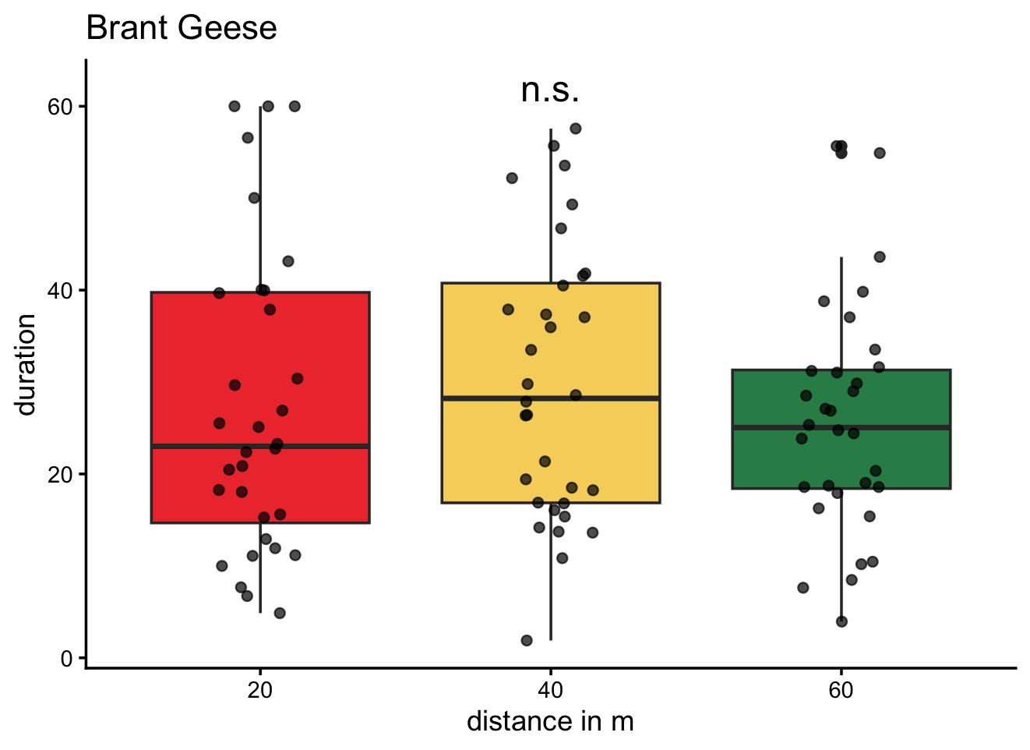
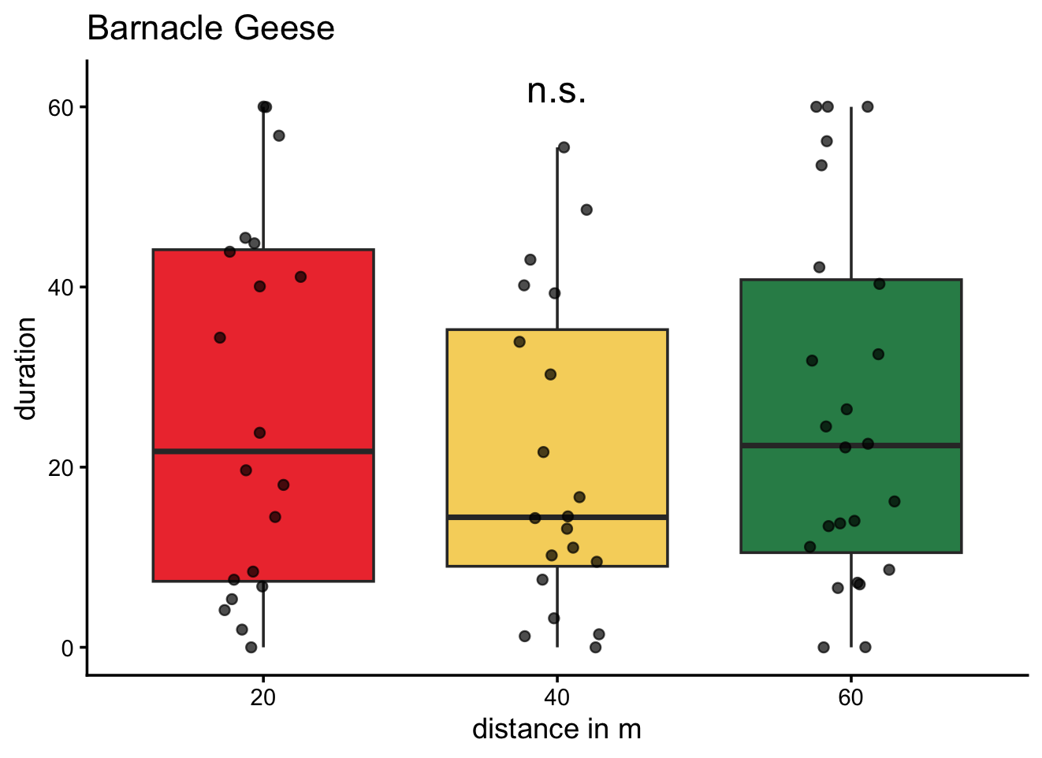
H1: Differences in duration due to differences in distance

Slide 24
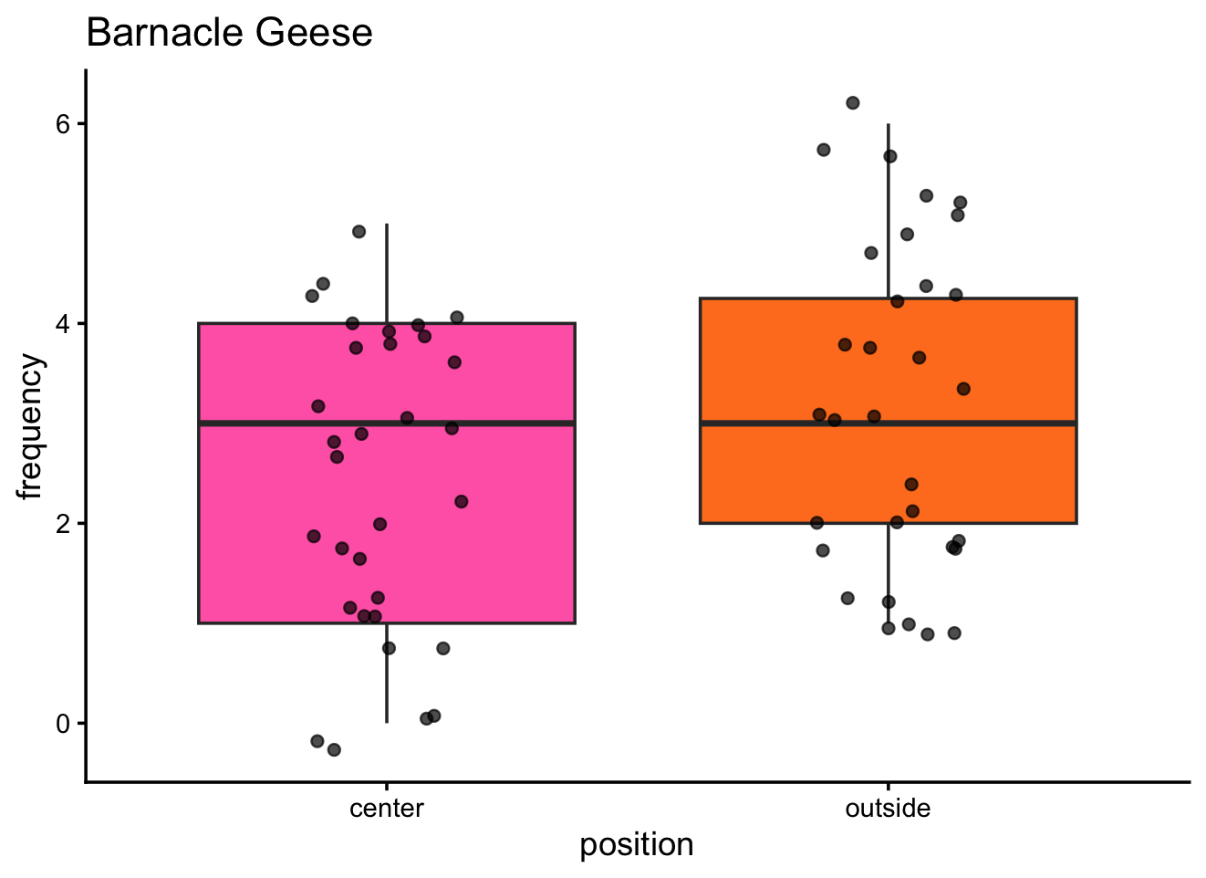
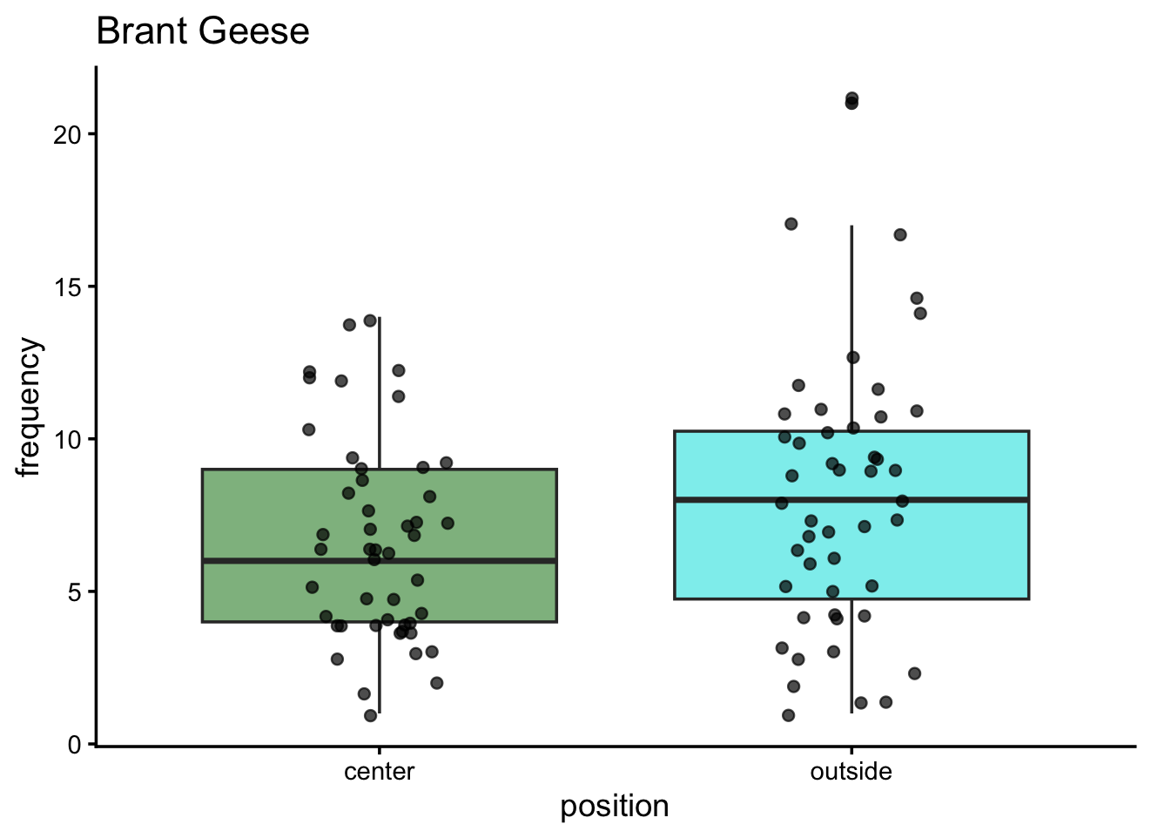
H2: differences in frequency due to position

Slide 25
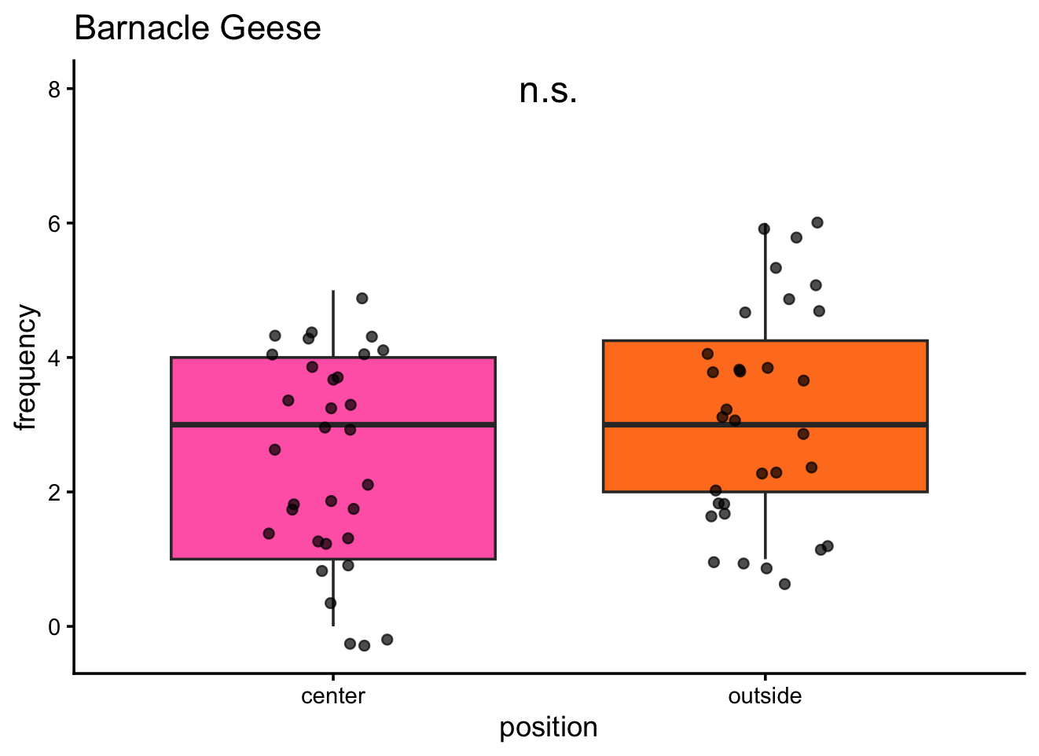
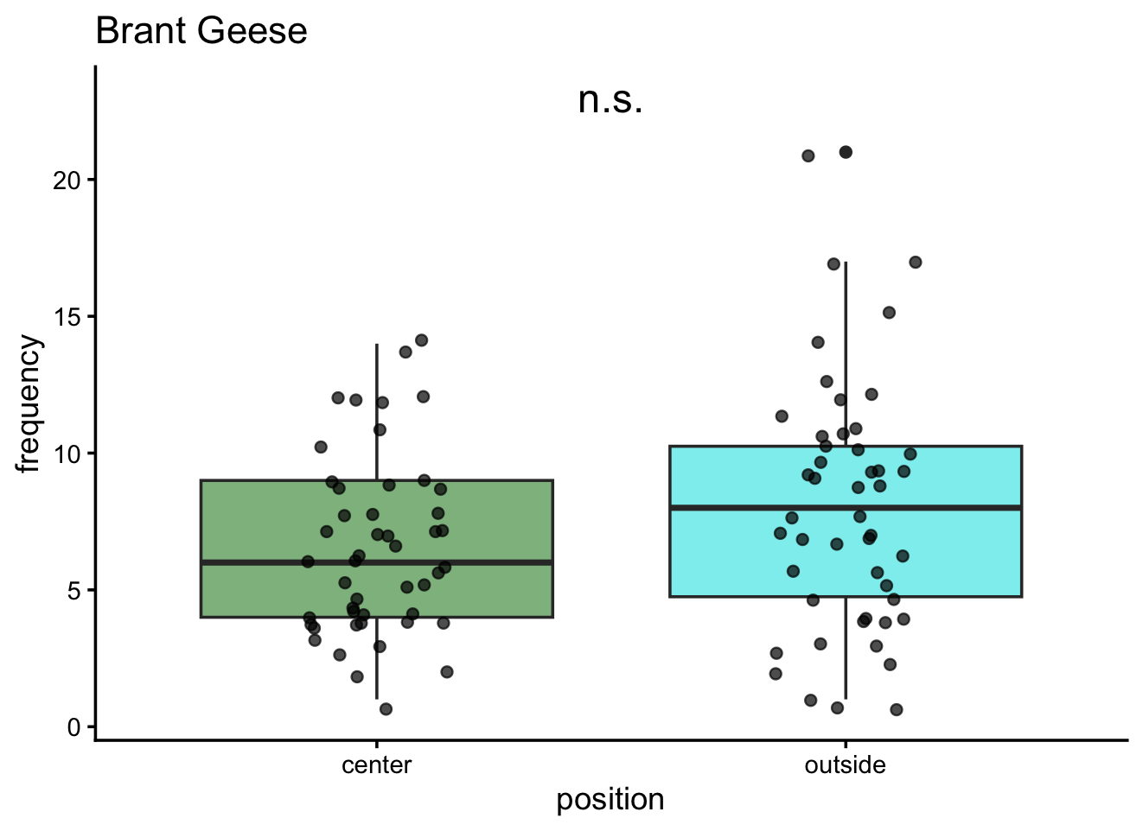
H2: differences in frequency due to position

Slide 26
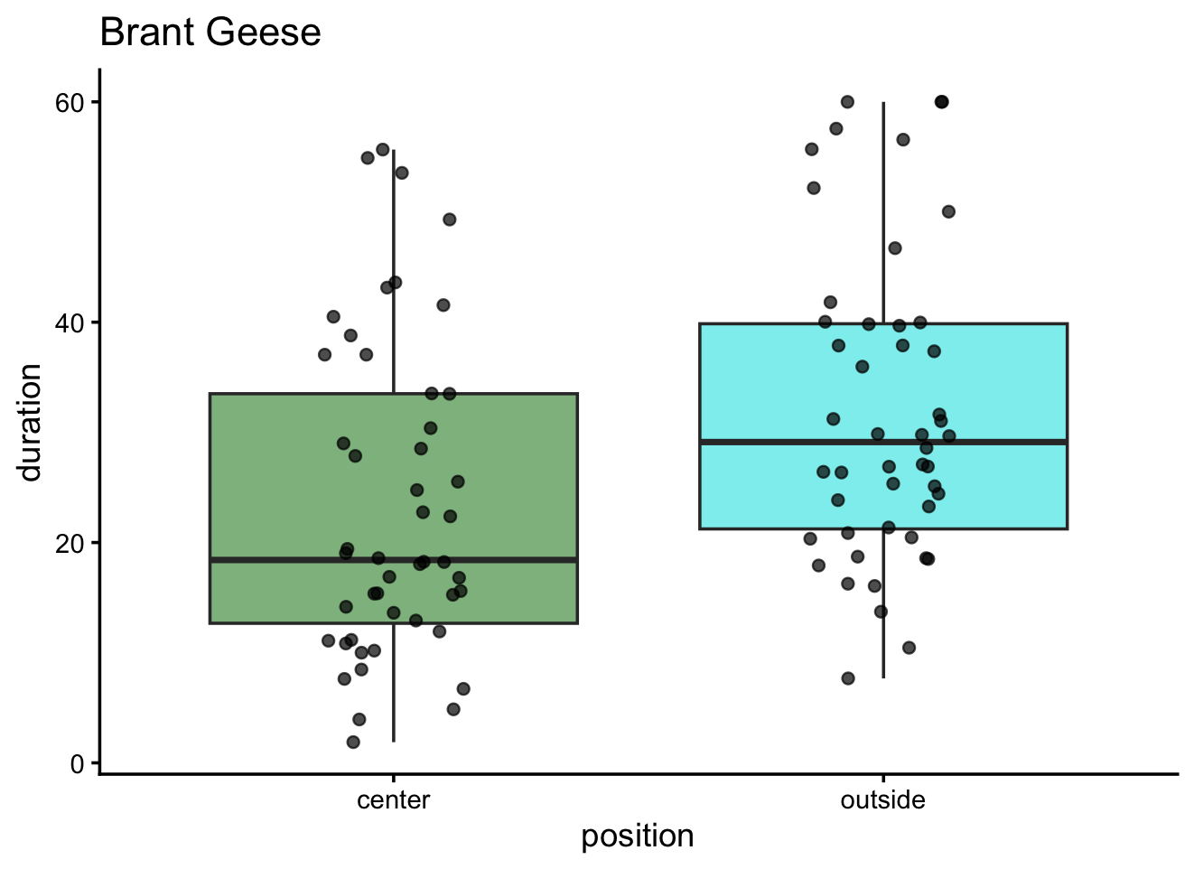
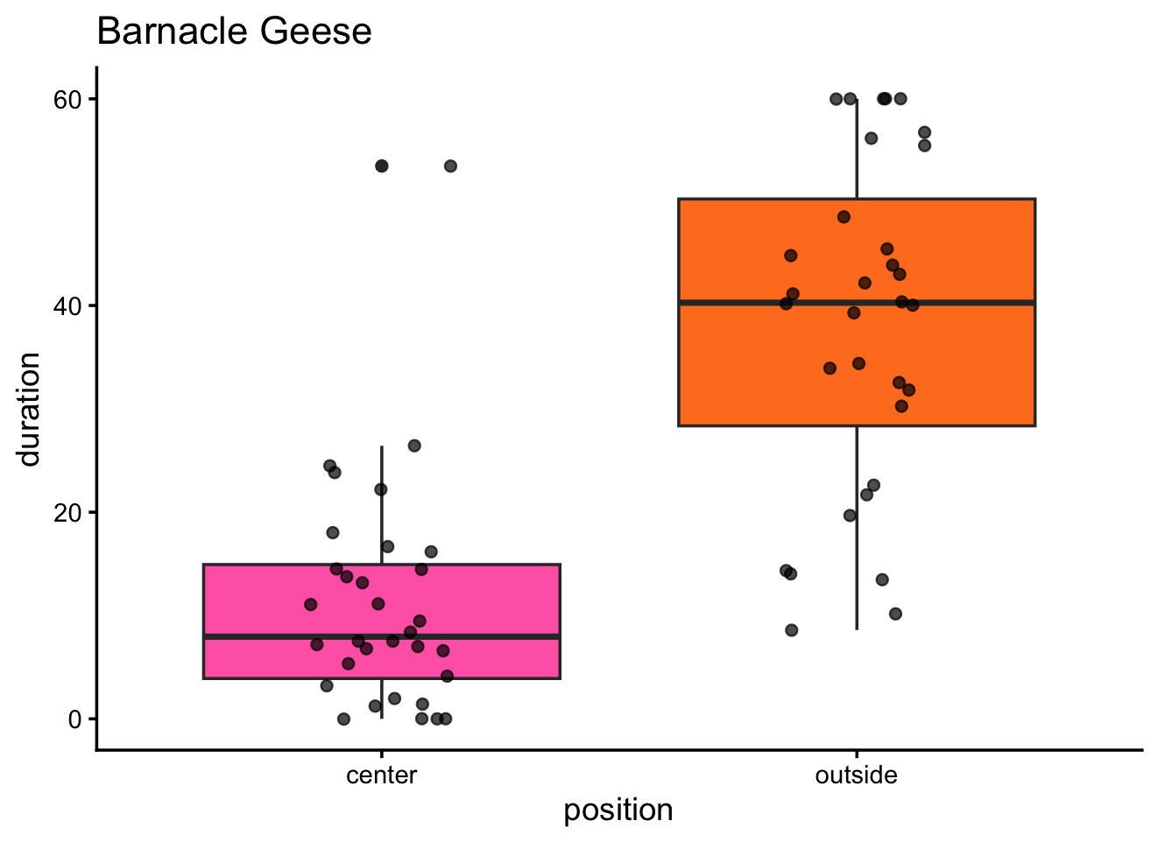
H2: differences in duration due to position

Slide 27
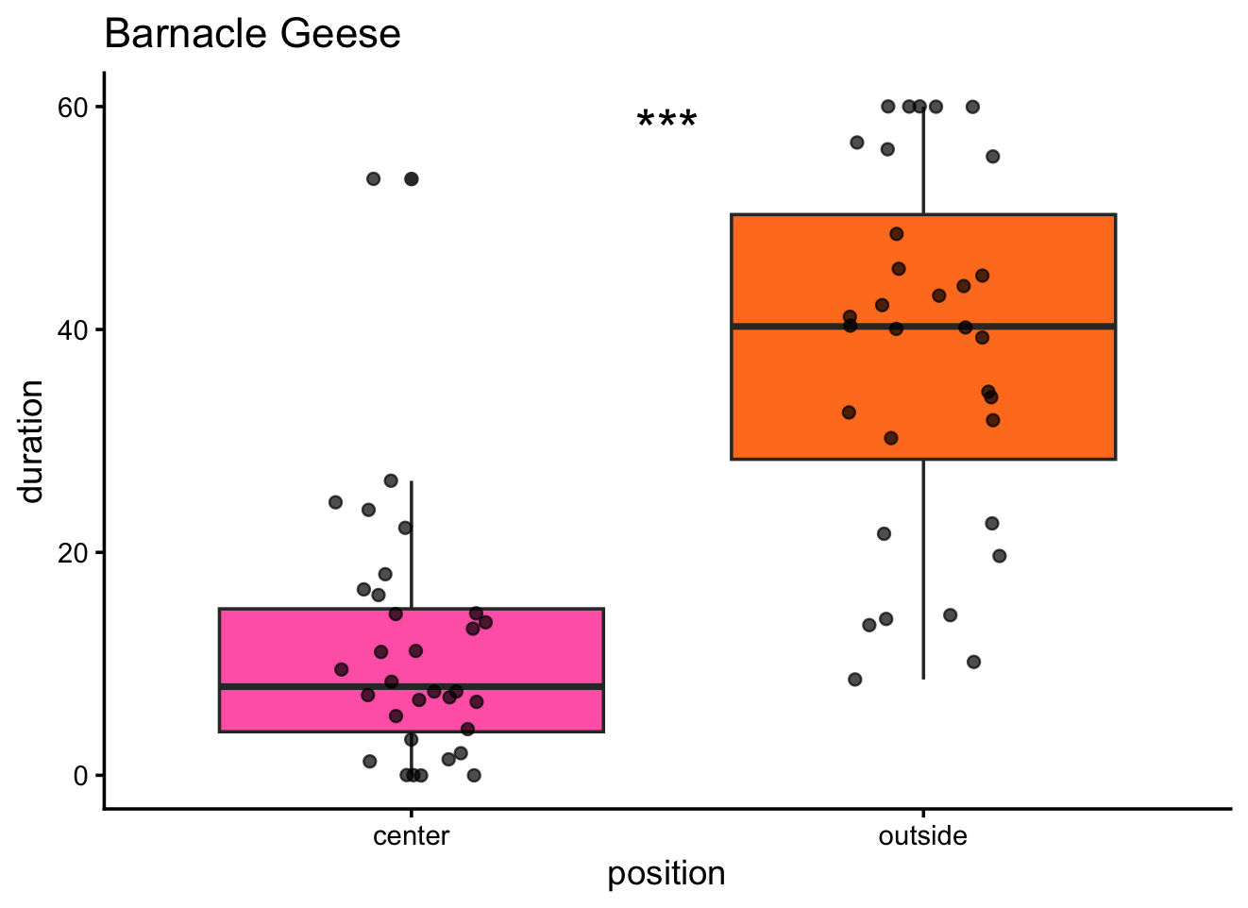
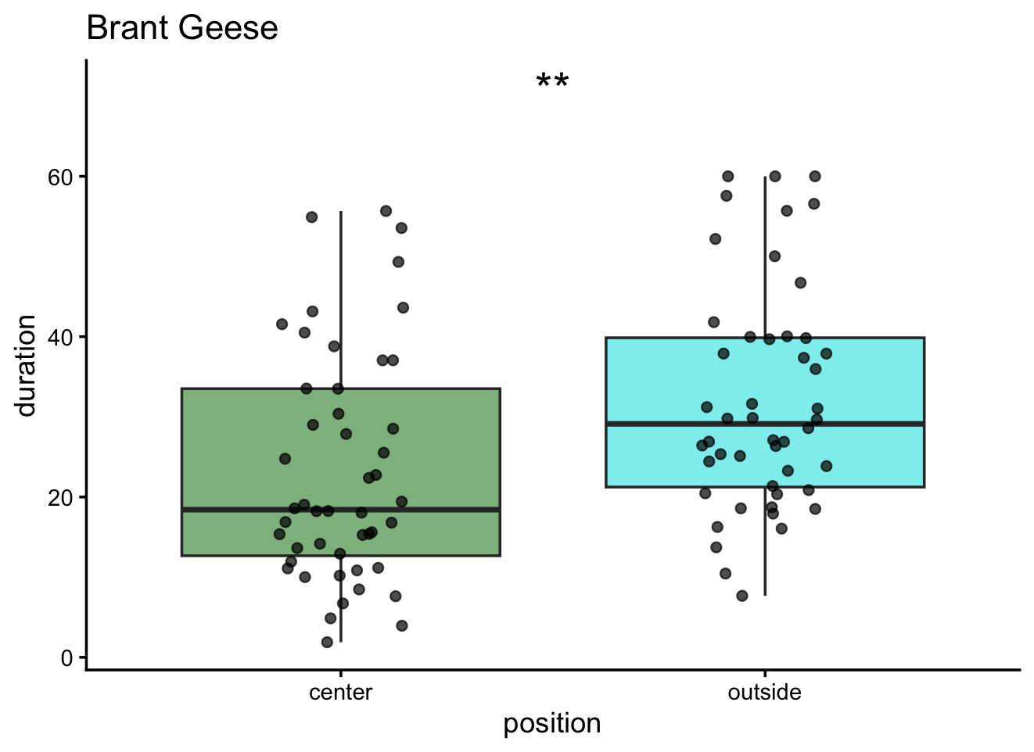
H2: differences in duration due to position

Slide 28
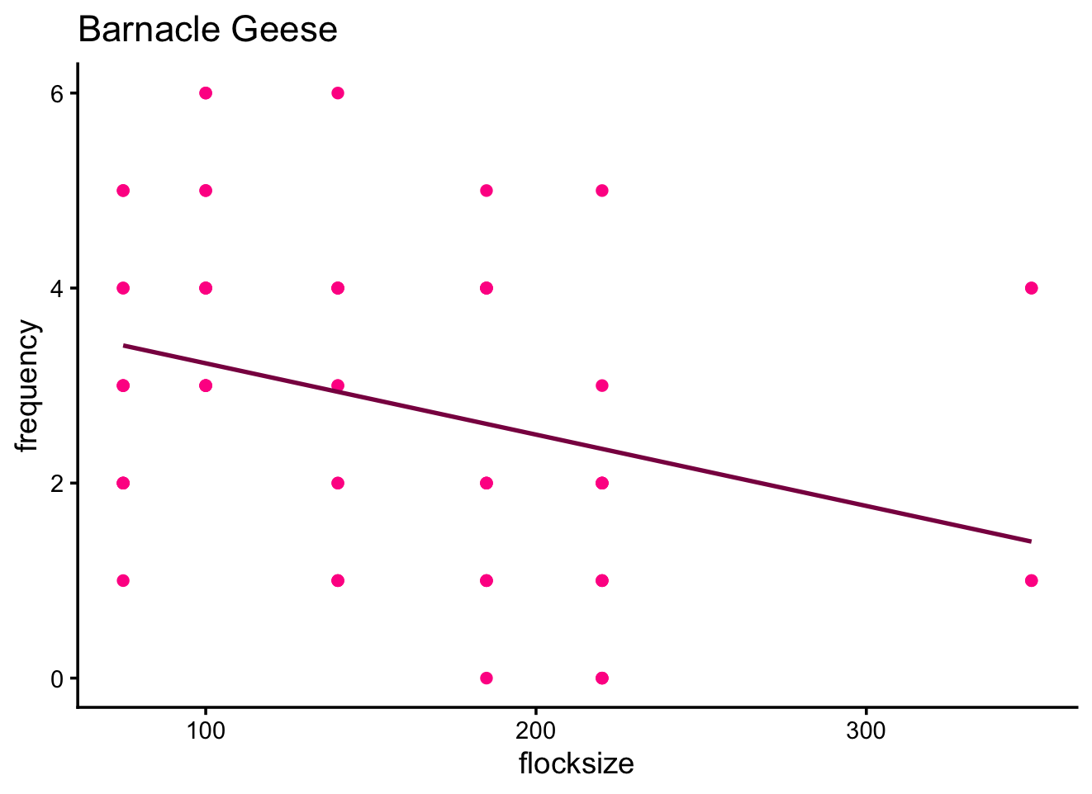
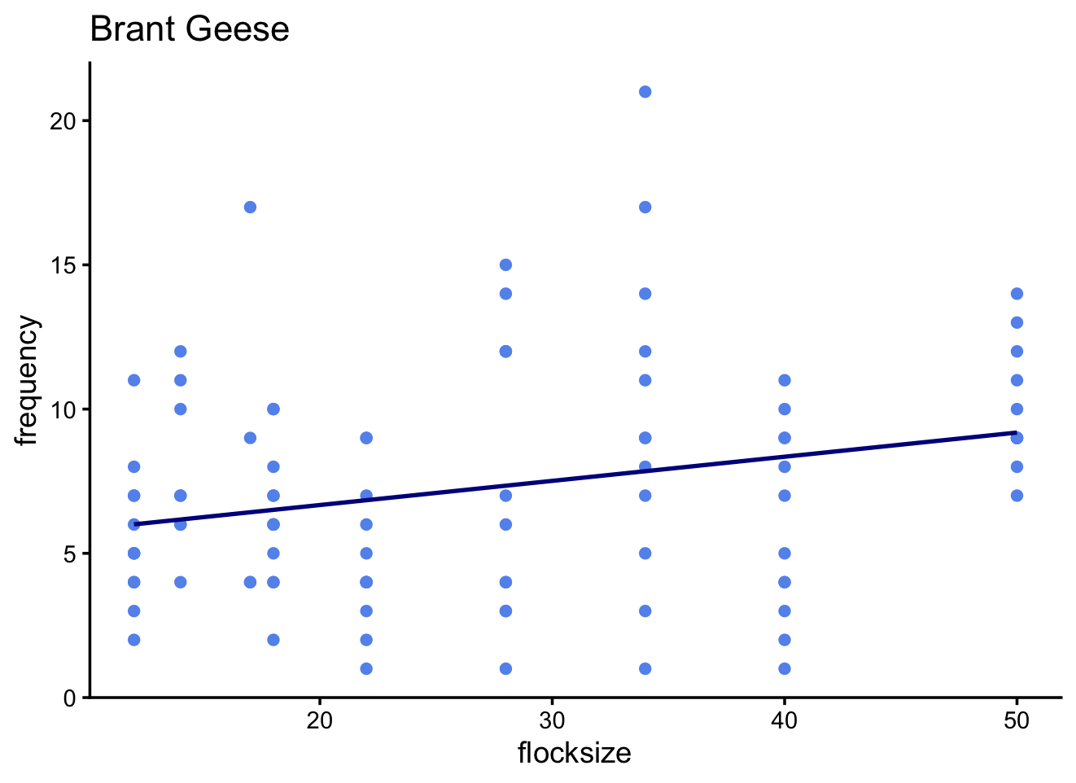
H4: Differences in frequency due to flocksize

Slide 29
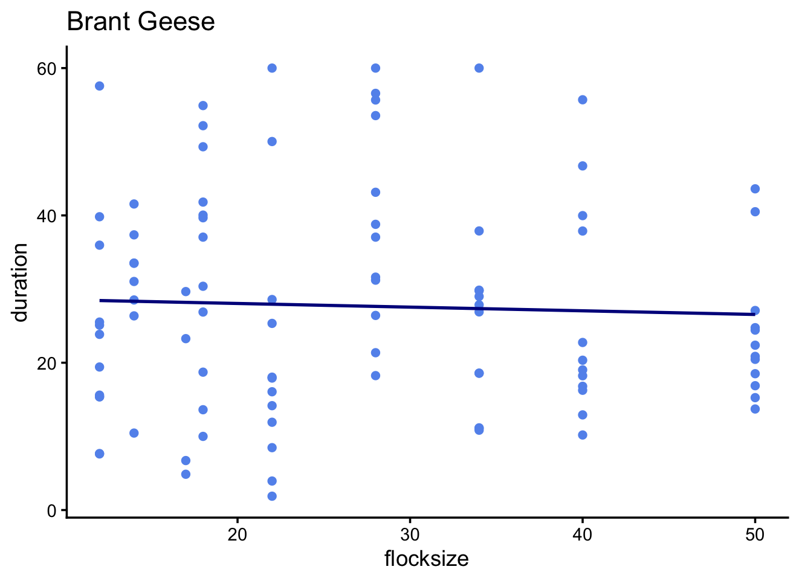
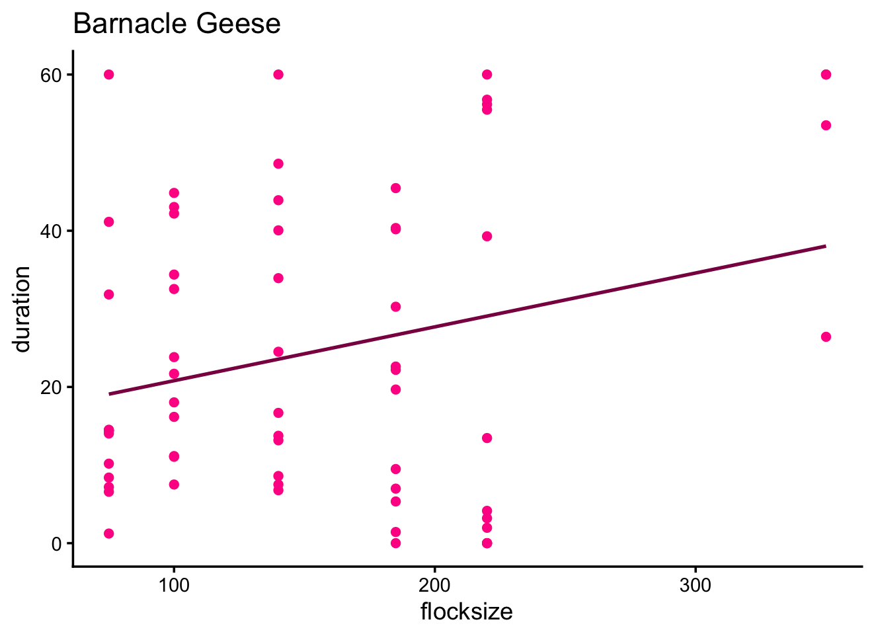
H4: differences in duration due to flocksize

Slide 30
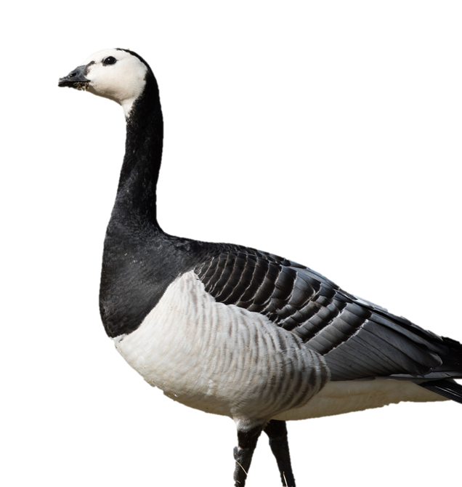
Results
Vigilance often appeared higher at closer distances (20 m > 40 m > 60 m)
Edge birds tended to show higher head-up frequency than center birds
Barnacle and Brent geese showed visible differences in scanning behaviour
Larger flocks showed a tendency for lower individual vigilance
Head-up duration showed smaller differences than frequency
Behaviour remained consistent across the three 1-minute recordings per flock

Slide 31
Discussion

Slide 32
Discussion
Increased vigilance at closer distances suggests geese may treat human presence as a potential threat (Frid &
Dill, 2002)
Higher vigilance at the flock edge supports the Edge Effect idea (Inglis & Lazarus, 1981)
Differences between Barnacle & Brent Geese suggest species-specific strategies
Declining vigilance with flock size aligns with the Many-Eyes effect (Beauchamp, 2008)

Slide 33
What We Could Improve - Limitations
Weather limited flock size
fog could have changed behaviour (concealing predators)
Time of day influenced geese behaviour
Distance sometimes varied > measured with google maps tool, may not be as accurate on such short distance
Some categories had fewer individuals
More sampling would strengthen patterns

Slide 34
Conclusion
Vigilance is a short but crucial safety behaviour in both species
Distance, flock position, and species identity all influence scanning patterns
Edge individuals remain more cautious than central birds
Group size reduces individual vigilance effort
Simple one-minute video samples can reveal clear behavioural trends
Together, the results highlight how geese balance food intake with risk awareness in real time

Slide 35
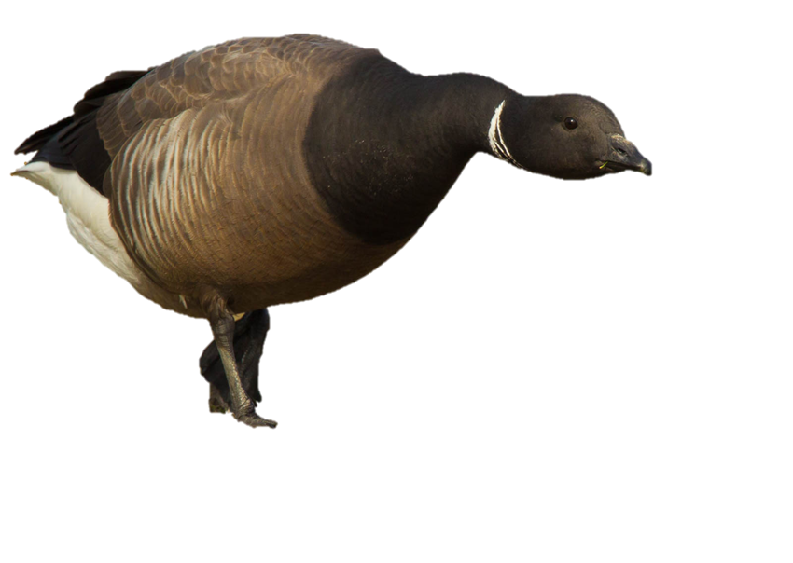
Thank you for your attention

